Slide 1

2025 Iowa Graduate Business Analytics Case Competition
Team 13

Slide 2





Team Members
Abishek Karnan Rajesh
Bharath Girirajan
Sudarsan Nallur Murali
Teja Sri Voota

Slide 3
Table of Content
Section | Page
1. Introduction | 6
2. Key People Involved in Dual Enrollment System | 5
3. Introduction to Dual Enrollment | 6
4. Key Drivers Behind Dual Enrollment Growth | 7
5. Dual Enrollment Trends in Iowa, South Dakota | 8
6. Dual Eligibility Drivers in Iowa | 10
7. Dual Eligibility Drivers in South Dakota | 11
8. Aging Population & Dual Eligibility | 12
9. Dual Eligibility by Age Group | 13
10. Forecasting Medicaid Risk Zones – Iowa | 14
11. Forecasting Medicaid Risk Zones – South Dakota | 15
12. Aging Workforce and Medicare Pressure | 16
13. Education and Healthcare Disparities | 17
14. Minimum Wage vs Inflation (Comparison) | 18
15. Minimum Wage vs Inflation (Impact) | 19
16. Bibliography | 21

Slide 4
Table of Abbreviations
Abbreviation | Explanation
ALS | Amyotrophic Lateral Sclerosis
API | Application Programming Interface
ARPA | American Rescue Plan Act
CMS | Centers for Medicare & Medicaid Services
COVID | Coronavirus Disease
FFCRA | Families First Coronavirus Response Act
FFS | Fee-For-Service
FPL | Federal Poverty Level
HI | Hospital Insurance
LIS | Low-Income Subsidy
MCO | Managed Care Organization
MSP | Medicare Savings Program
SMI | Supplementary Medical Insurance
SSDI | Social Security Disability Insurance
FRED | Federal Reserve Economic Data
BLS | U.S. Bureau of Labor Statistics
US | United States
HHS | Department of Health and Human Services
SNP | Special Needs Plans
MA | Medicare Advantage

Slide 5
Key People Involved In Dual Enrollment Ecosystem Key players across government, healthcare, private sector, and regulatory bodies driving dual eligibility and healthcare delivery.
Government Bodies
Healthcare
Beneficiary
Private Sector
Regulatory Body
Federal
Government
Pharma
Senior Citizen
Managed Care Organization
US Dept of Health Human service
ARPA
Hospital
People with ALS
Private Insurance Company
CMS
Taxpayers
Nurse
End stage with renal disease
Wellmark
State Government
Doctors
Disabilities
FFCRA
Physicians
Introduction
Geographic Trends
Funding / Forecast – Age Factor
Impact of Education
Economic Trends
Conclusion
Bibliography

Slide 6

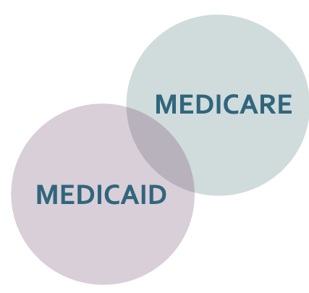
Introduction to Dual Enrollment Trends
The rise in dual enrollment post-COVID highlights shifting healthcare needs and expanded access in underserved communities.
When COVID-19 struck, it wasn’t just a public health crisis—it sparked a surge in demand for medical coverage across the nation.
To ensure health access, the federal government introduced new provisions, allowing unrestricted Medicaid enrollment for those without existing coverage.
In Iowa and South Dakota, this shift was especially visible through a notable increase in dual enrollment—individuals qualifying for both Medicare and Medicaid.
This raised an essential question: Why this sudden increase?
What is Dual Enrollment?
Dual enrollment refers to individuals who qualify for both Medicare (typically age-based or disability-based) and Medicaid (income-based).
This group often includes the most vulnerable populations—low-income seniors and individuals with chronic health needs.
Year
2019 | 2,52,98,220
2020 | 2,59,34,360
Introduction
Geographic Trends
Funding / Forecast – Age Factor
Impact of Education
Economic Trends
Conclusion
Bibliography

Slide 7
Key Drivers Behind Dual Enrollment Growth
Economic hardship, COVID impact, policy changes, aging population, and awareness are fueling the enrollment surge.
Economic Hardship
Income inequality
Rising inflation
Stagnant wages
COVID-19’s Direct Impact
Sudden job loss
Employer-provided coverage loss
Policy Changes
FFCRA and ARPA expanded Medicaid eligibility
States paused disenrollment
Many individuals faced reduced financial stability, pushing them into Medicaid eligibility
COVID’s economic ripple effect hit lower-income groups hardest.
A safety net was created to prevent people from falling through.
Aging Population
Increased number of individuals reaching Medicare eligibility
Many also qualify for Medicaid due to income thresholds
Growing Awareness
Outreach and education efforts increased
Simplified application processes
Especially in rural regions of Iowa and South Dakota.
More people knew about and accessed dual coverage options.
Introduction
Geographic Trends
Funding / Forecast – Age Factor
Impact of Education
Economic Trends
Conclusion
Bibliography

Slide 8
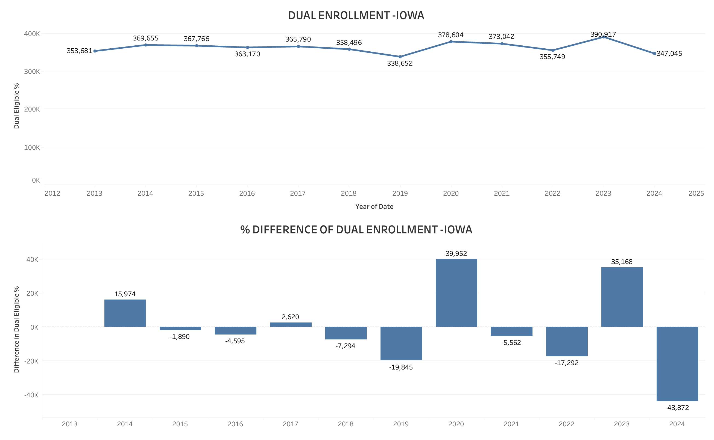
Dual Enrollment Trends in Iowa (2013–2024)
Fluctuations Reveal Policy Impact and Post-Pandemic Shifts
Total dual enrollment in Iowa, which peaked during the COVID-19 response years and fluctuated as federal waivers and state policies shifted.
The year-over-year differences, highlights notable enrollment spikes in 2020 (+39,952) due to emergency/unrestricted Medicaid access under FFCRA and ARPA.
However, 2024 shows a sharp decline (-43,872)—a possible result of eligibility redeterminations and disenrollments following the unwinding of pandemic-era protections.
Dual enrollment is highly sensitive to federal and state policy, making proactive planning essential for managing healthcare access. Heading towards a downward trend post pandemic
Introduction
Geographic Trends
Funding / Forecast – Age Factor
Impact of Education
Economic Trends
Conclusion
Bibliography

Slide 9
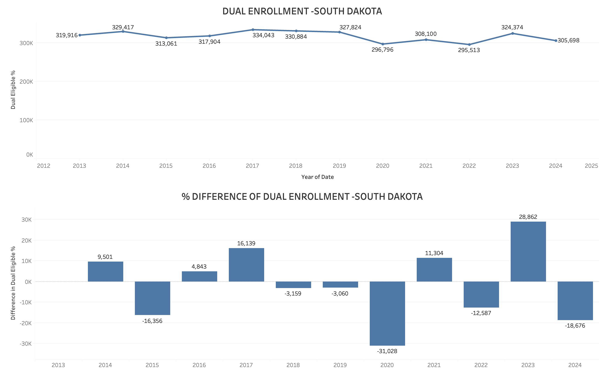
Dual Enrollment Trends in South Dakota (2013–2024)
Fluctuations Reveal Policy Impact and Post-Pandemic Shifts
South Dakota’s dual enrollment shows a more erratic trend compared to Iowa
A notable decline in 2019 (-31,026) is followed by a spike in 2021 (+28,662)—reflecting the impact of pandemic-era Medicaid expansion efforts
This further confirms that post pandemic there is a downward trend in dual enrollment
The inconsistency in dual enrollment highlights a need for stronger outreach to maintain healthcare continuity in vulnerable populations.
Introduction
Geographic Trends
Funding / Forecast – Age Factor
Impact of Education
Economic Trends
Conclusion
Bibliography

Slide 10
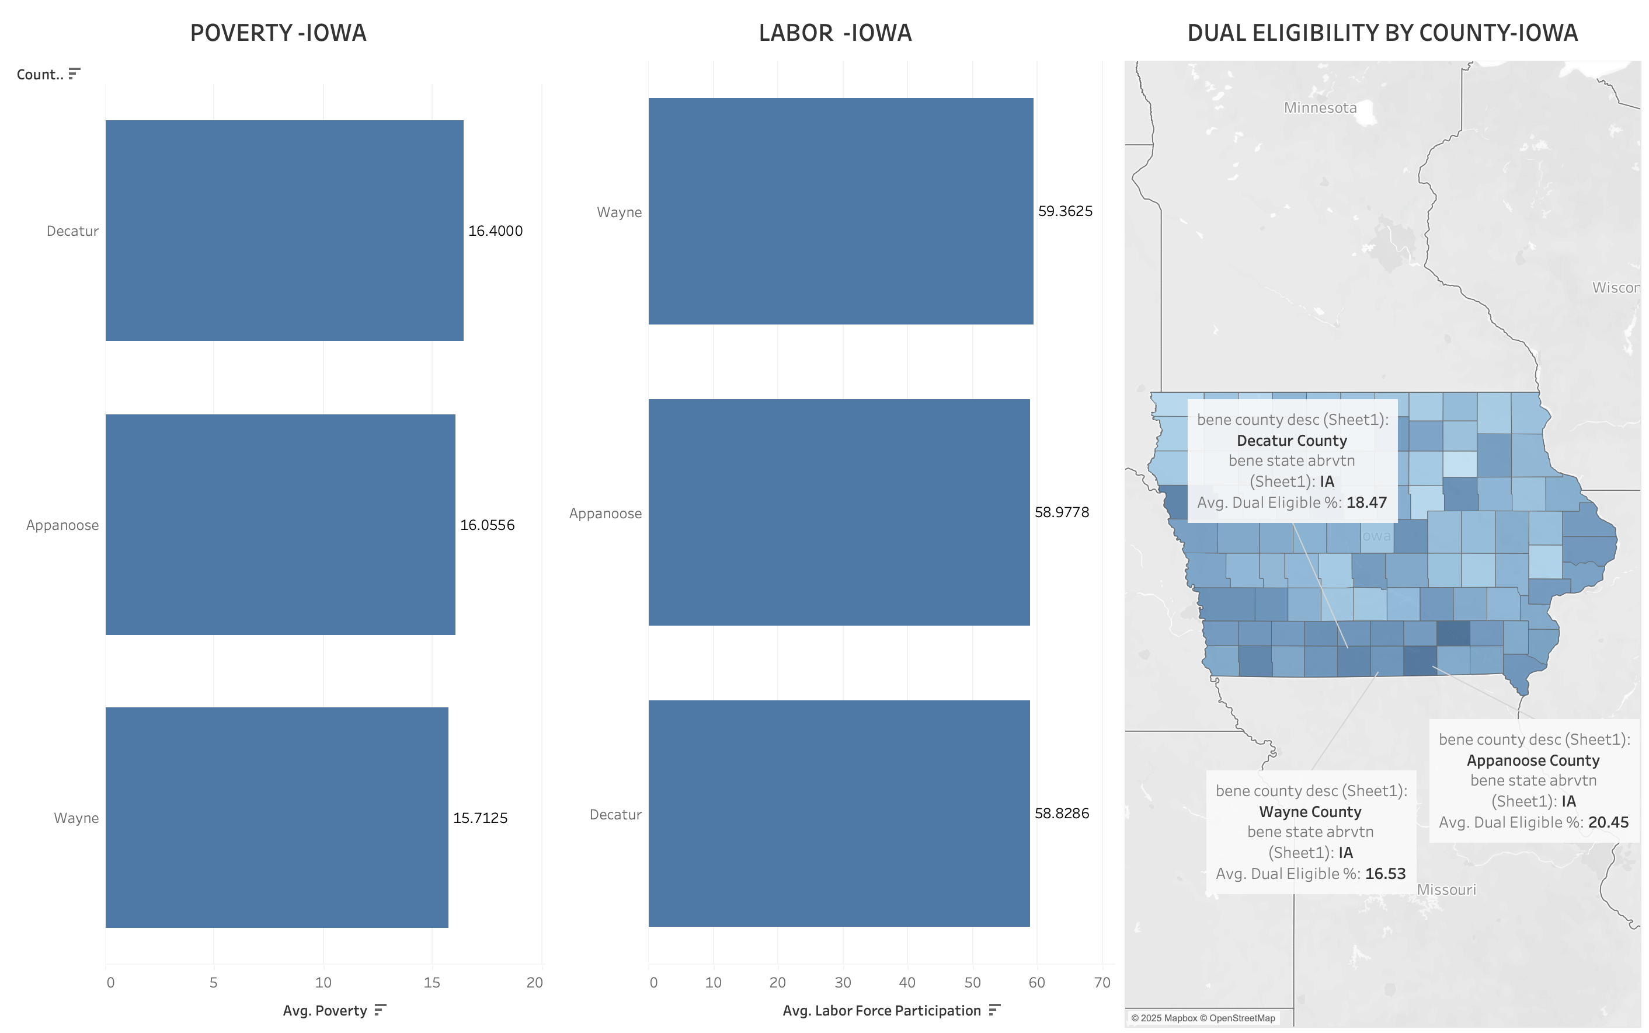
Dual Eligibility Drivers in Iowa
Poverty and labor trends expose Medicaid-vulnerable counties
As poverty increases, labor participation declines — and dual eligibility rises.
Introduction
Geographic Trends
Funding / Forecast – Age Factor
Impact of Education
Economic Trends
Conclusion
Bibliography

Slide 11
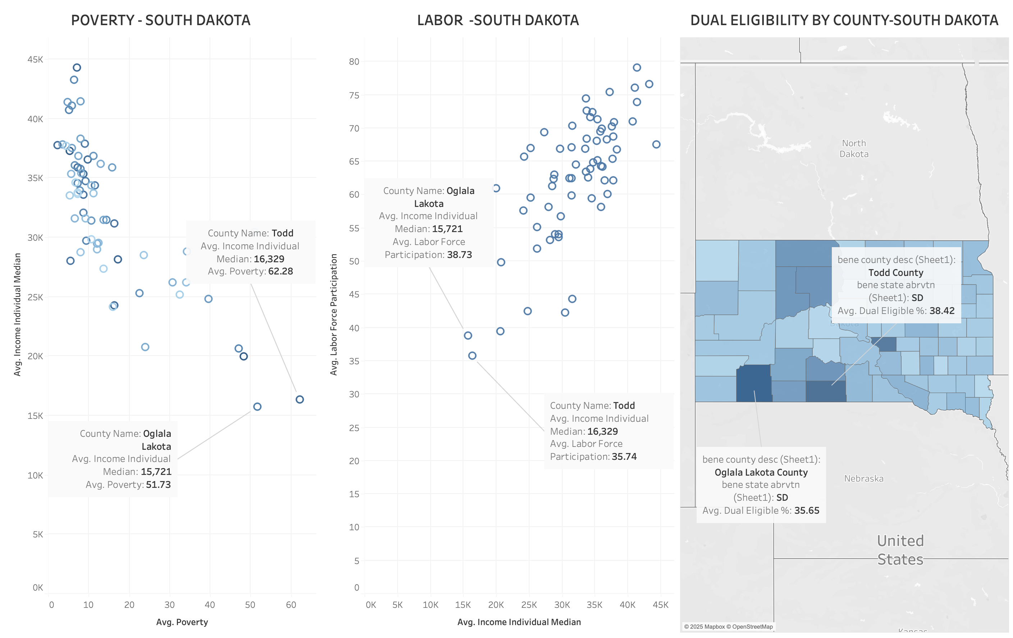
Dual Eligibility Drivers in South Dakota
Low income, high poverty, and weak labor force participation predict Medicaid vulnerability
As poverty rises and labor participation drops, dual eligibility climbs.
Introduction
Geographic Trends
Funding / Forecast – Age Factor
Impact of Education
Economic Trends
Conclusion
Bibliography

Slide 12
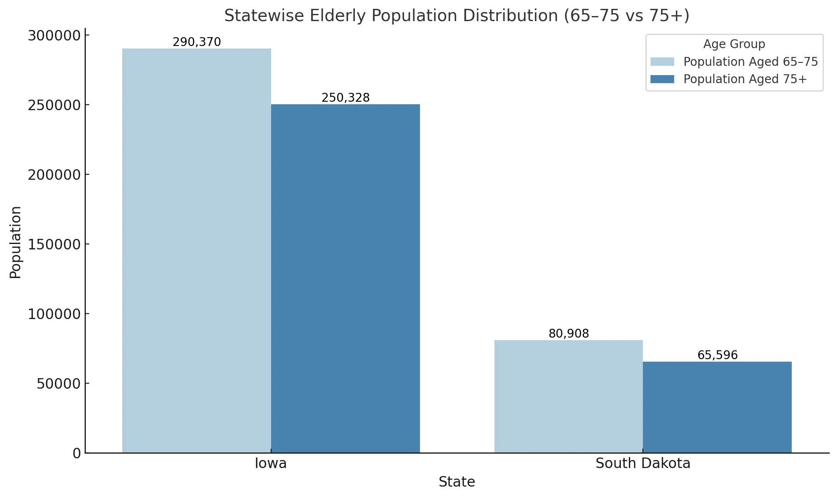
Aging Population & Dual Eligibility
A growing elderly population in Iowa and South Dakota signals rising dual enrollment needs and long-term care demands.
Iowa
The distribution is slightly right-skewed, indicating a higher concentration of middle-aged individuals.
Majority of the population has a median age between 35 and 50.
This suggests a relatively aging population, which aligns with the workforce sustainability risk you’ve previously explored.
South Dakota
The distribution is more symmetric, with a wider spread across different age brackets.
There is a noticeable peak around age 40, but the presence of both younger and older zip code medians suggests a more balanced demographic.
Insight:
Over 370,000 people in Iowa and South Dakota are currently aged 65–75. In the next decade, most will transition into the 75+ category—where healthcare needs accelerate.
Why It Matters:
75+ are 4x more likely to enroll in hospice care
Dual eligibility (Medicare + Medicaid) spikes after 75
Increased demand for chronic care, support programs, and coordinated coverage
What Wellmark Can Do:
Forecast dual-eligibility growth ZIP-wise
Expand hospice + eldercare partnerships
Launch targeted preventive care at age 65
Enhance support for long-term care planning
“The age wave is coming. By planning today, Wellmark can lead tomorrow’s care—efficiently, compassionately, and proactively.”
Introduction
Geographic Trends
Funding / Forecast – Age Factor
Impact of Education
Economic Trends
Conclusion
Bibliography

Slide 13
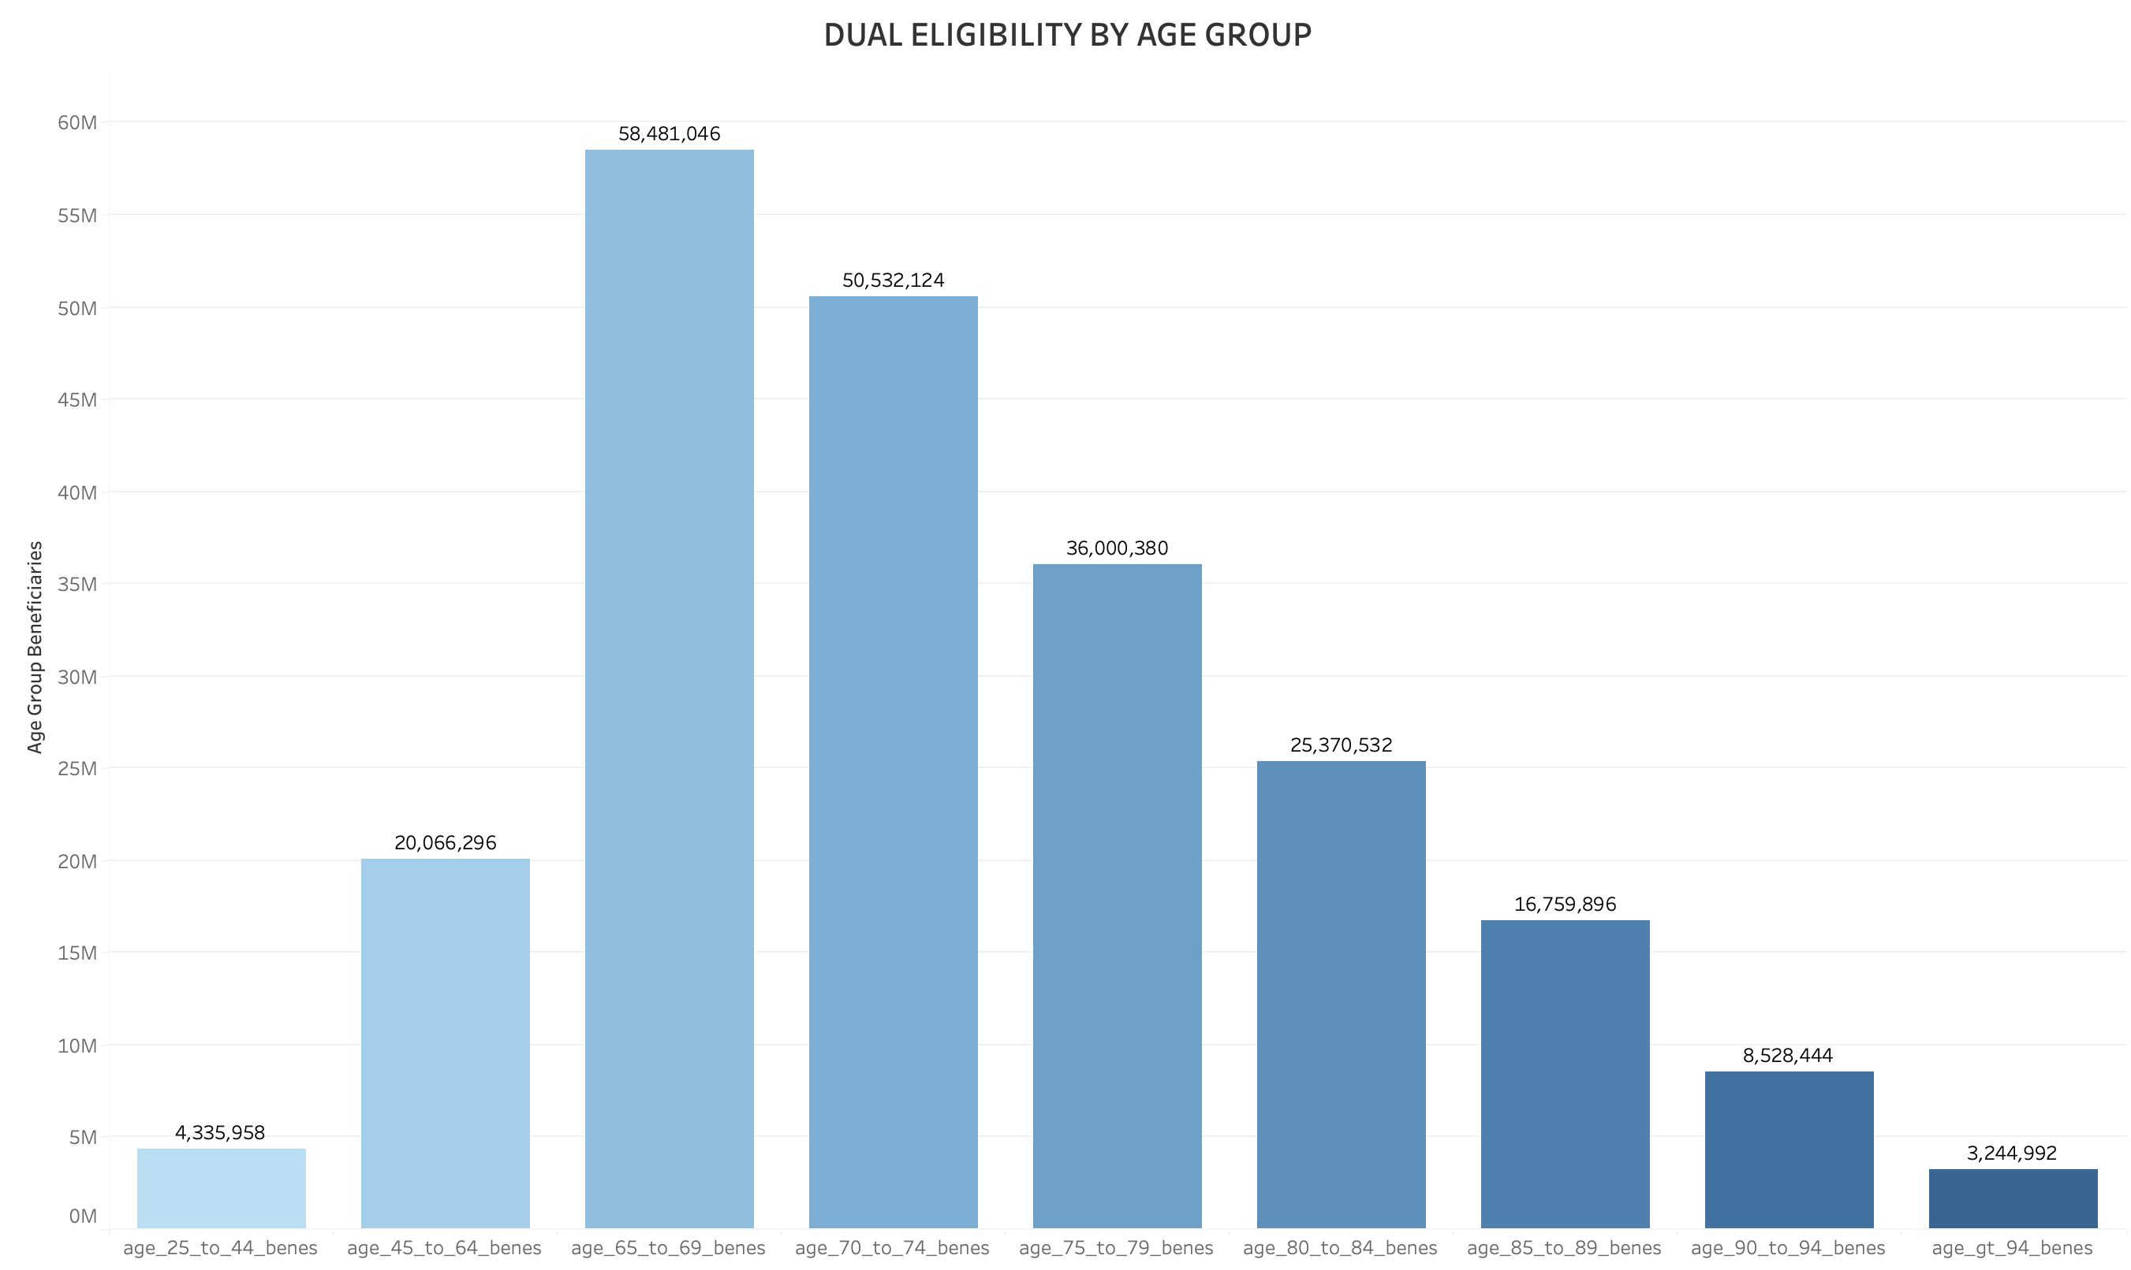
Dual Eligibility by Age Group
Understanding the Age-Driven Surge in Dual Enrollment.
In the next 5–15 years, 20 million people will enter the 65+ age group, dramatically expanding the population eligible for dual enrollment.
Dual eligibility is highest among individuals aged 65–74, with a significant presence above age group 75.
This pattern reflects the natural overlap between Medicare eligibility (typically 65+) and income-based Medicaid support, especially among retirees and those with chronic conditions.
As the aging population grows, this demographic is expected to drive future demand for integrated care, coordinated benefits, and long-term support services.
The demographic shift toward an older population means dual eligibility demand will surge, especially between 2030 and 2040. This underscores the need for early policy planning, capacity building, and targeted healthcare delivery for aging Americans.
Introduction
Geographic Trends
Funding / Forecast – Age Factor
Impact of Education
Economic Trends
Conclusion
Bibliography

Slide 14
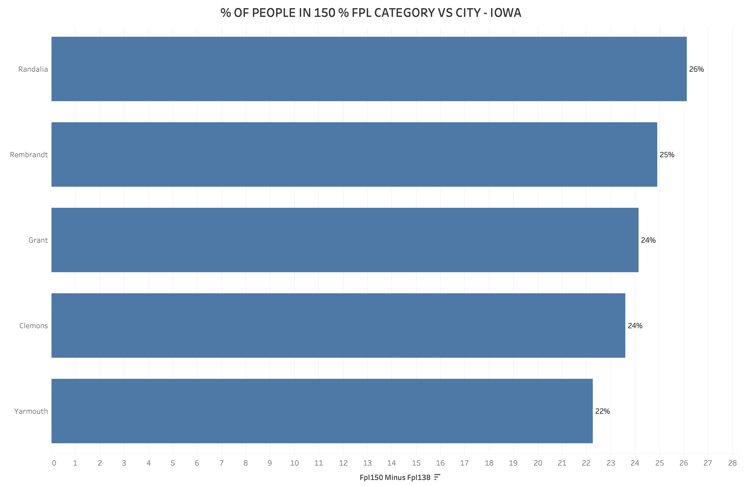
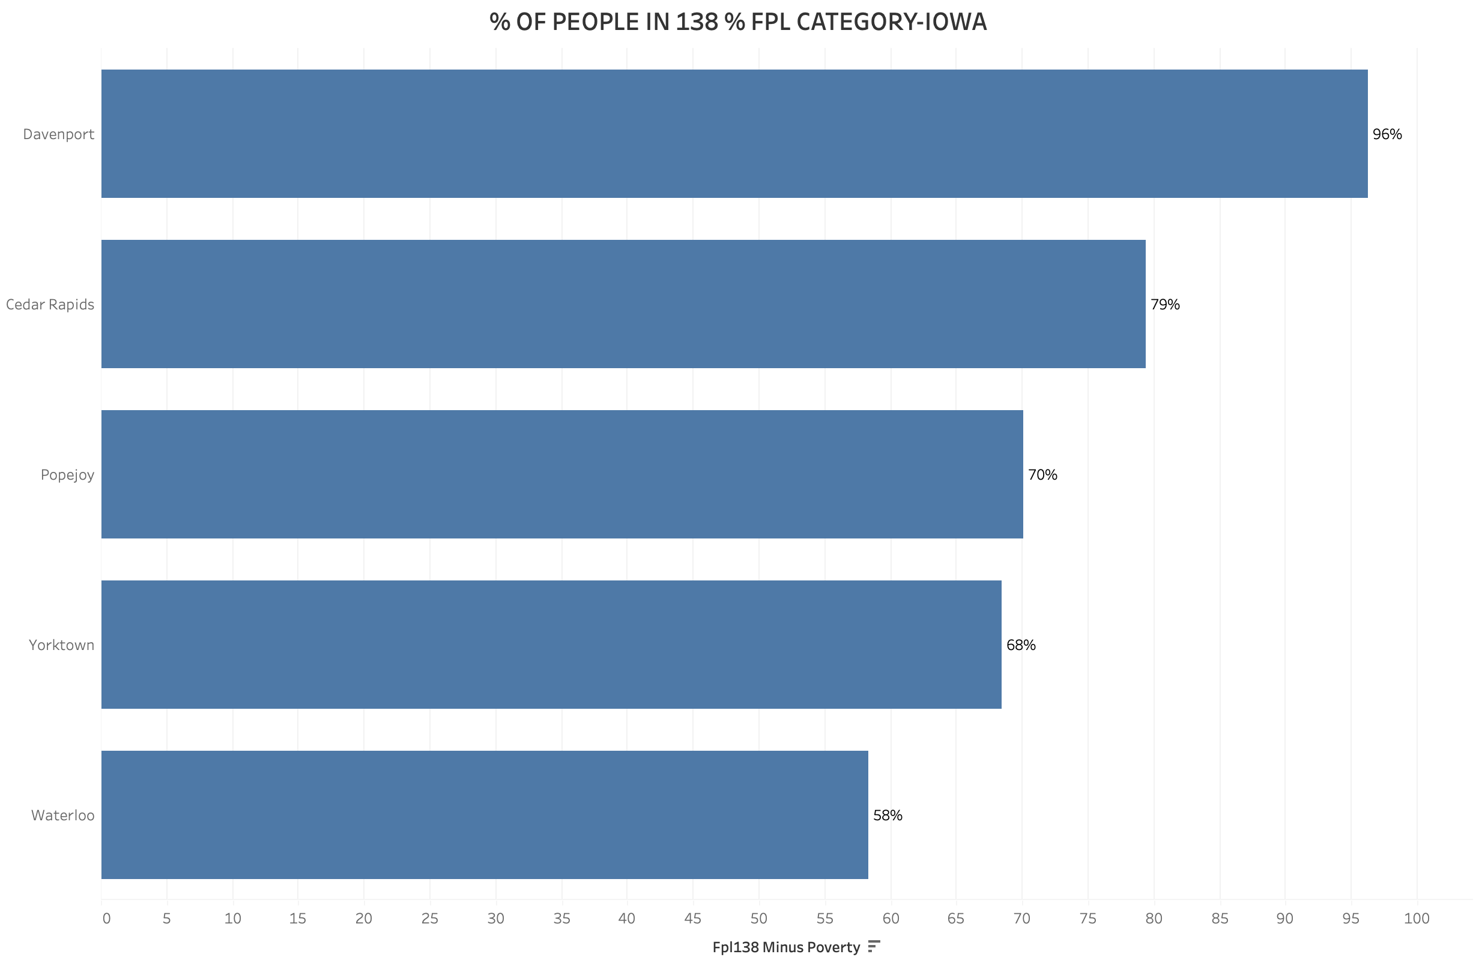
Forecasting Medicaid Risk Zones in Iowa Cities nearing poverty thresholds and rising eligibility
These cities are “on the edge” of Medicaid eligibility
These cities are moving towards high poverty levels
These are “at-risk” cities where a large portion of residents hover just above the Medicaid eligibility threshold (138% FPL). As inflation rises and wages stagnate, many individuals in these cities could soon fall below the threshold, making them eligible for Medicaid.
This chart shows cities where an overwhelming share of residents are nearing or below 100% of the FPL—indicating deep poverty and a high likelihood of long-term Medicaid dependency if inflation continues.
If inflation continues unchecked, the cities in Graph 1 may soon mirror the poverty rates of Graph 2. Early identification and action can help prevent a healthcare access crisis.
Introduction
Geographic Trends
Funding / Forecast – Age Factor
Impact of Education
Economic Trends
Conclusion
Bibliography

Slide 15
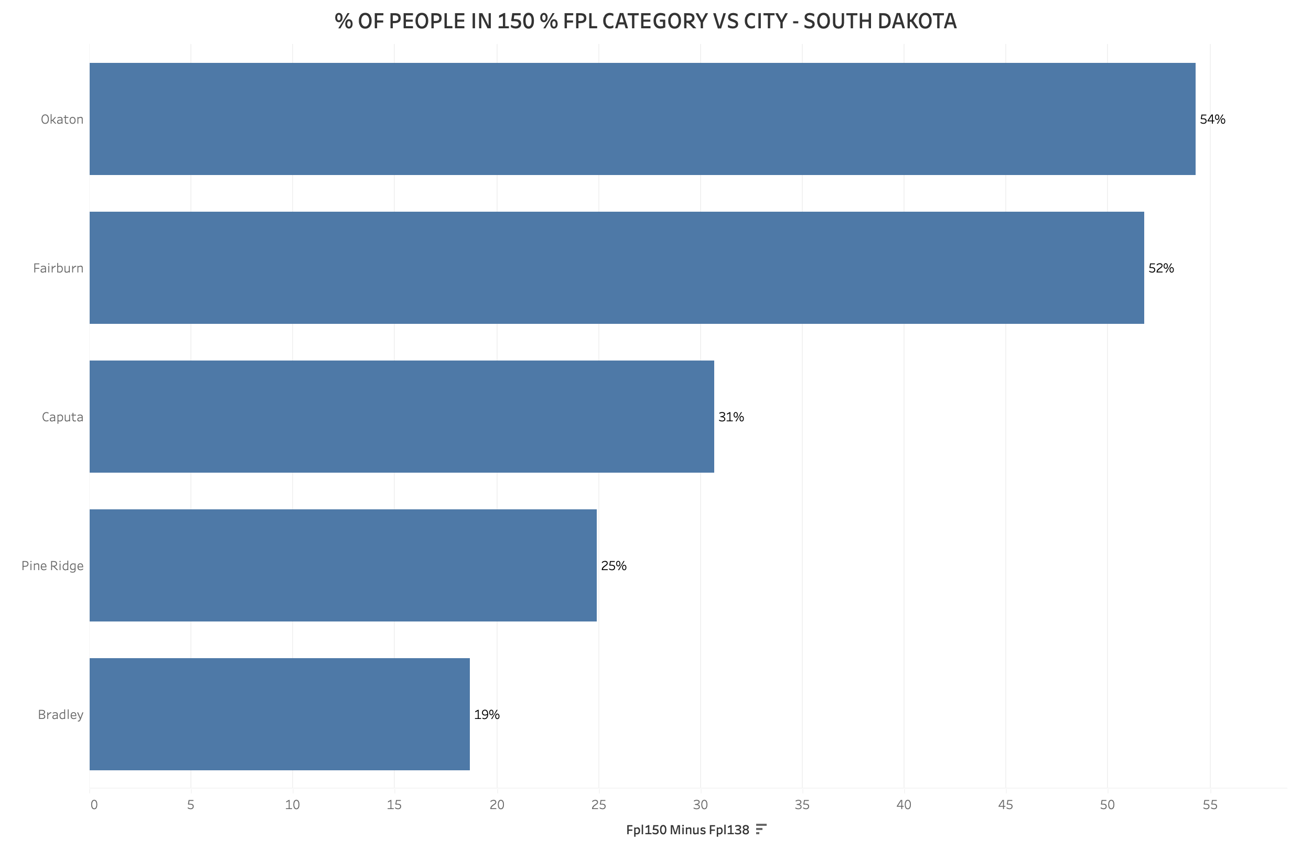
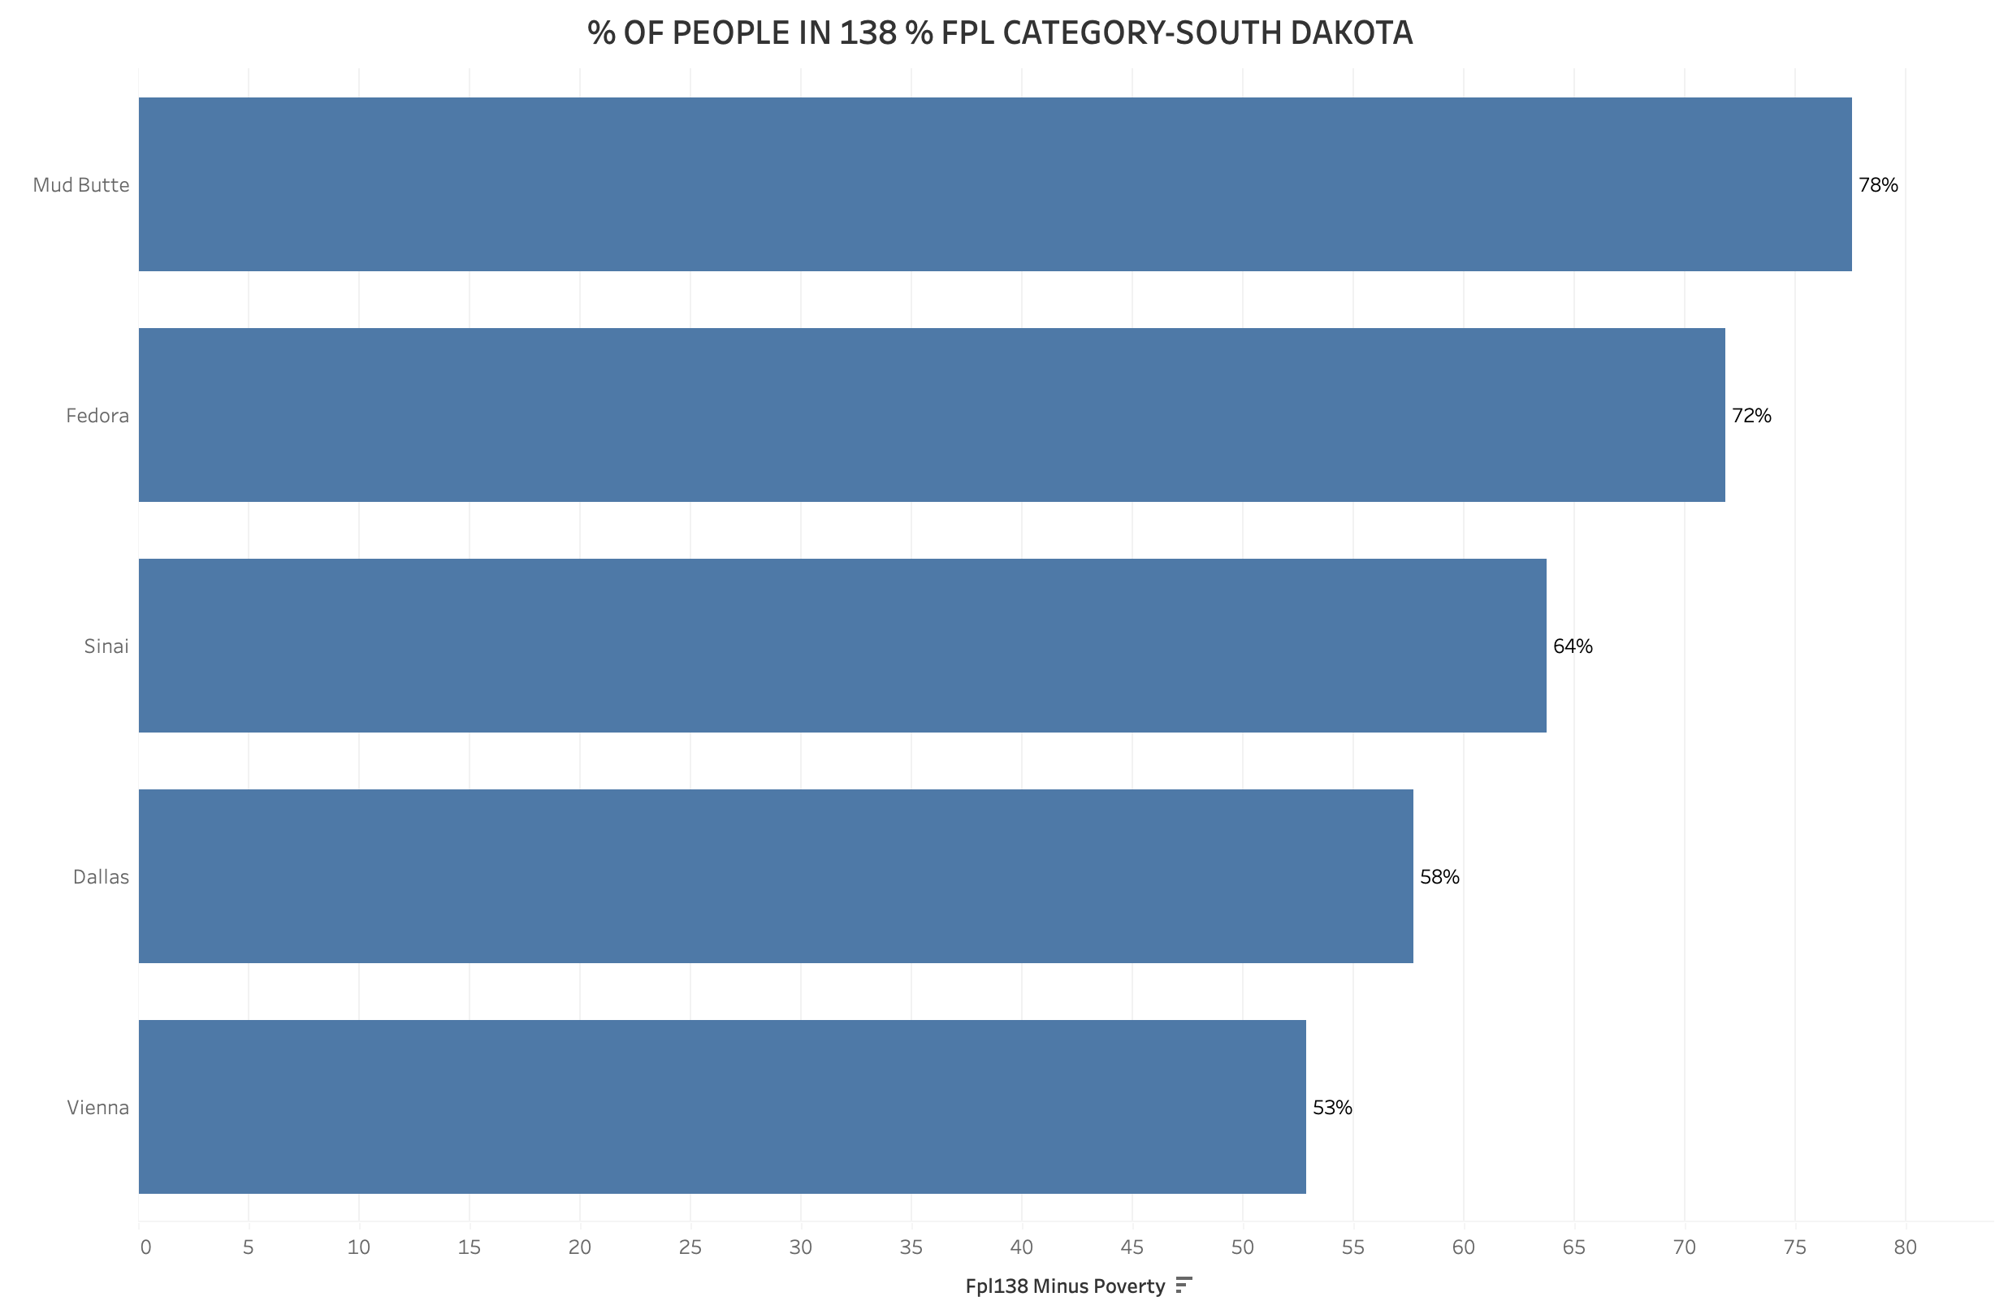
Forecasting Medicaid Risk Zones in South Dakota Cities nearing poverty thresholds and rising eligibility
These cities are “on the edge” of Medicaid eligibility
These cities are moving towards high poverty levels
These are “at-risk” cities where a large portion of residents fall just above the Medicaid eligibility threshold (138% FPL). Rising inflation and stagnant wages could soon push these individuals below the line, qualifying them for Medicaid.
These areas already have a high concentration of people nearing or below the poverty line (100% FPL). This indicates a strong dependency on Medicaid and a need for long-term care planning, especially if economic pressures persist.
If inflation continues unchecked, the cities in Graph 1 may soon mirror the poverty rates of Graph 2. Early identification and action can help prevent a healthcare access crisis in South Dakota.
Introduction
Geographic Trends
Funding / Forecast – Age Factor
Impact of Education
Economic Trends
Conclusion
Bibliography

Slide 16
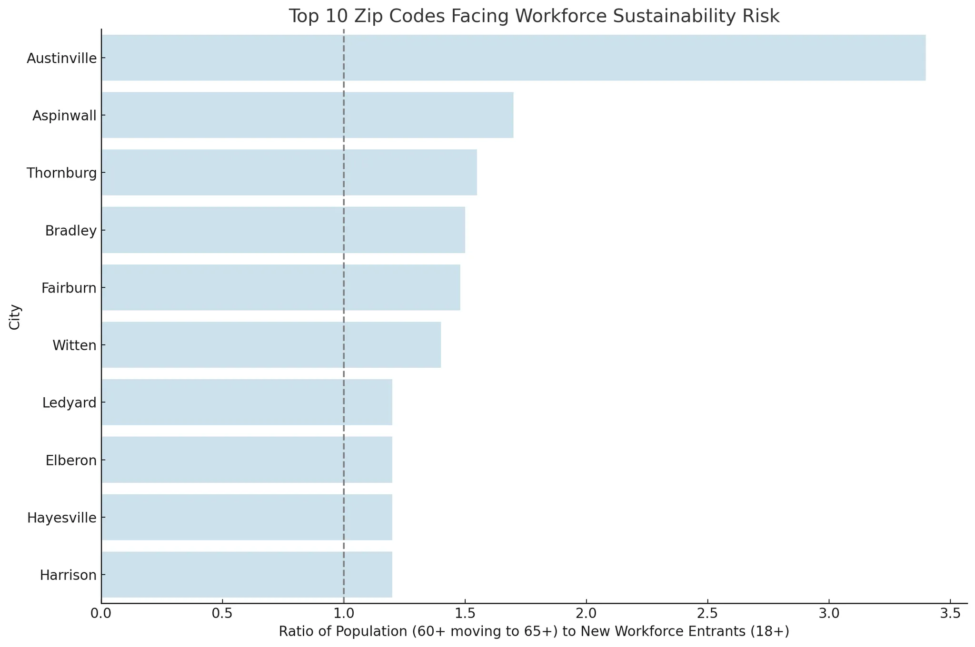
Aging Workforce and Medicare Pressure
Fewer young workers and more retirees signal rising dual-eligibility and funding strain
The number of people entering the workforce (ages 18–24 & 20s) is significantly lower than those aging into 65+, particularly in cities like Austinville, Aspinwall, and Thornburg.
As more people retire, they become eligible for Medicare and dual-eligibility programs (Medicare + Medicaid).
Fewer people are working, meaning fewer are:
Contributing to Medicare through payroll taxes
Holding private employer-sponsored insurance
Impact | Effect
More retirees | Increased demand for public health programs
Fewer workers | Fewer payroll tax contributions
Budget strain | Medicare funding burden on existing taxpayers
Coverage gaps | Communities may face healthcare access challenges
Wellmark can take a proactive role in:
Forecasting dual-eligible care demands over the next 10 years
Targeting outreach & prevention in towns with the highest aging ratios
Introduction
Geographic Trends
Funding / Forecast – Age Factor
Impact of Education
Economic Trends
Conclusion
Bibliography

Slide 17
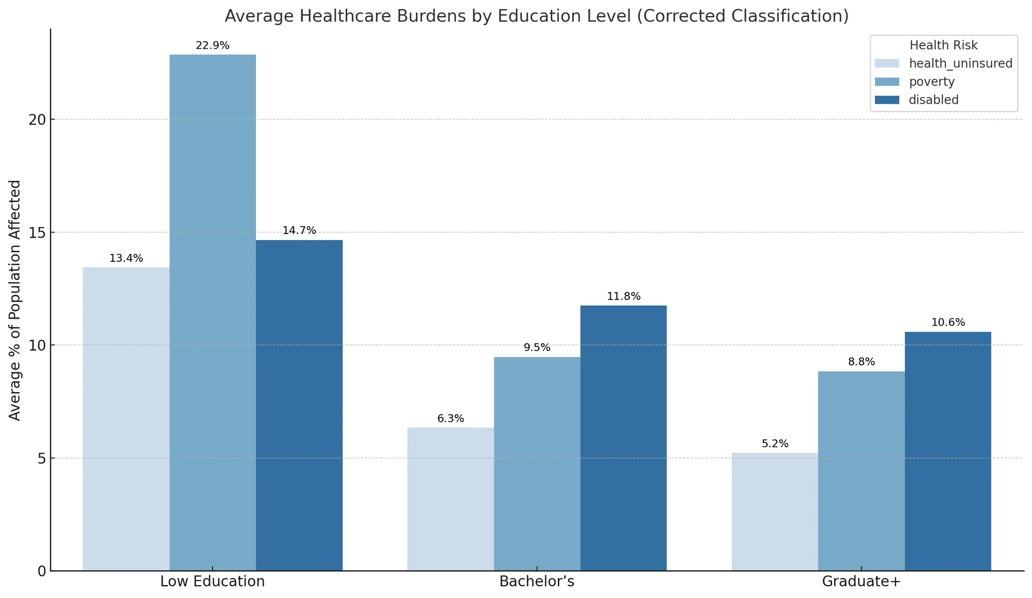
Education and Healthcare Disparities in Iowa
Lower education levels correlate with higher uninsured rates, poverty, and disability burdens
Low Education Areas Bear the Heaviest Healthcare Burdens
ZIP codes where “Low Education” is most prevalent show the highest levels of:
Uninsured population
Poverty
Disability
These burdens are consistently higher than in ZIPs dominated by Bachelor’s or Graduate education levels.
2. Higher Education Levels Correlate with Disability
In Bachelor’s and Graduate communities:
Uninsured rates are significantly lower
Poverty and disability rates decline
This supports a protective effect of education on long-term health outcomes.
3. Disparities Are Not Marginal — They're Substantial
In some cases, the gap between Low Education and Graduate+ ZIPs is over 10 percentage points in uninsured and poverty rates.
This gap represents a policy and intervention opportunity.
Lower education levels are strongly linked to higher rates of being uninsured, in poverty, or disabled—highlighting a critical policy gap.
Introduction
Geographic Trends
Funding / Forecast – Age Factor
Impact of Education
Economic Trends
Conclusion
Bibliography

Slide 18
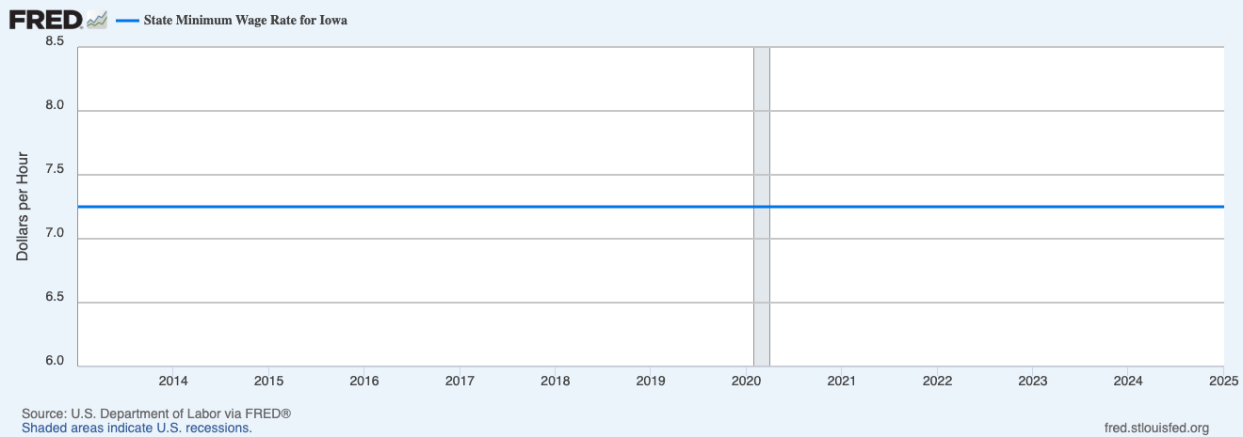
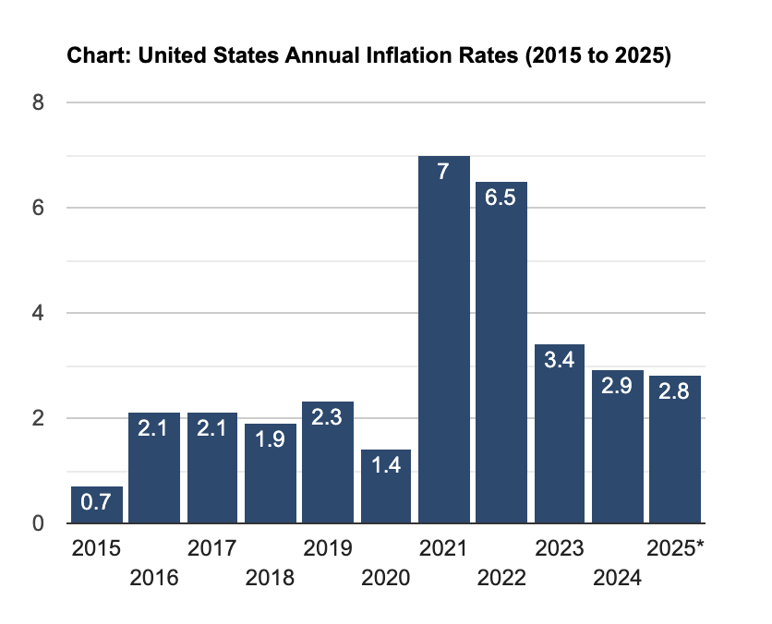
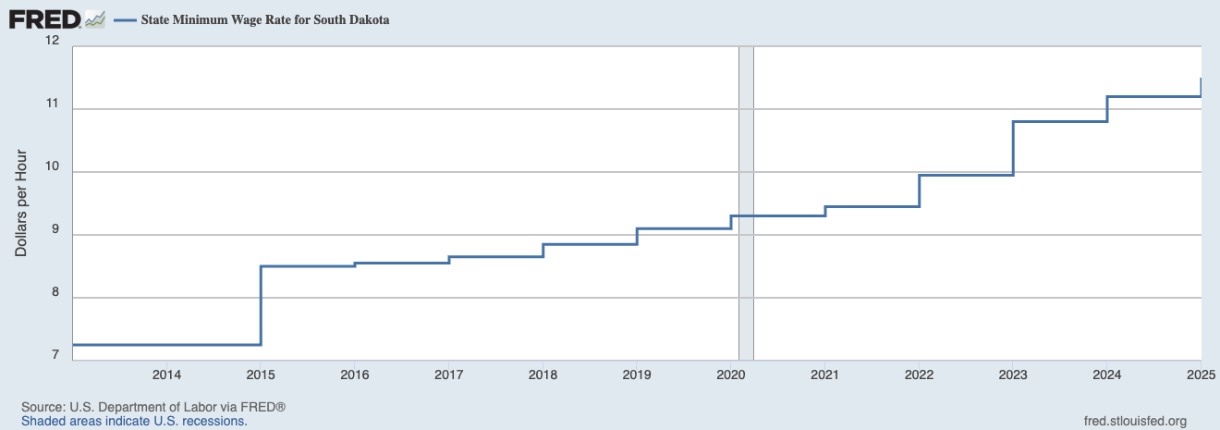
Minimum Wage vs Inflation: A Tale of Two States
Static wages in Iowa and gradual increases in South Dakota reveal contrasting responses to rising inflation and affordability challenges.
Iowa’s Standstill: Despite rising inflation, Iowa’s minimum wage has remained unchanged at $7.25/hour for over a decade, failing to keep pace with the cost of living.
South Dakota’s Response: In contrast, South Dakota adjusted its minimum wage nearly every year, showing a commitment to match earnings with inflationary pressures.
A Growing Gap: While inflation soared, static wages in Iowa widened the gap between income and affordability — unlike South Dakota, where gradual hikes helped cushion the impact.
Introduction
Geographic Trends
Funding / Forecast – Age Factor
Impact of Education
Economic Trends
Conclusion
Bibliography

Slide 19
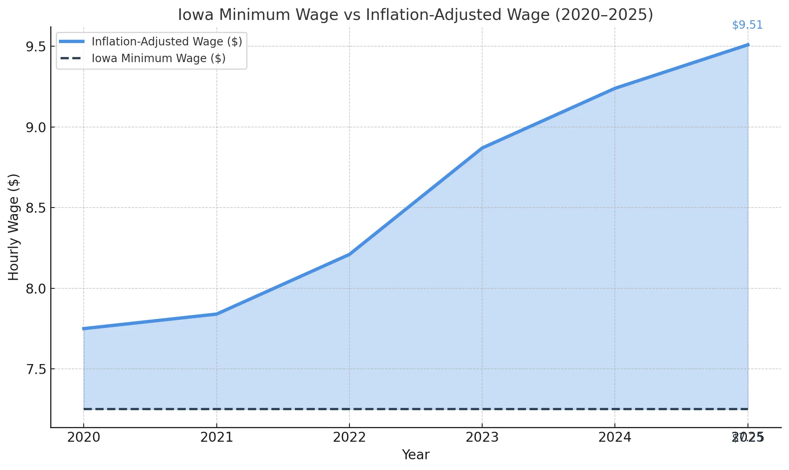
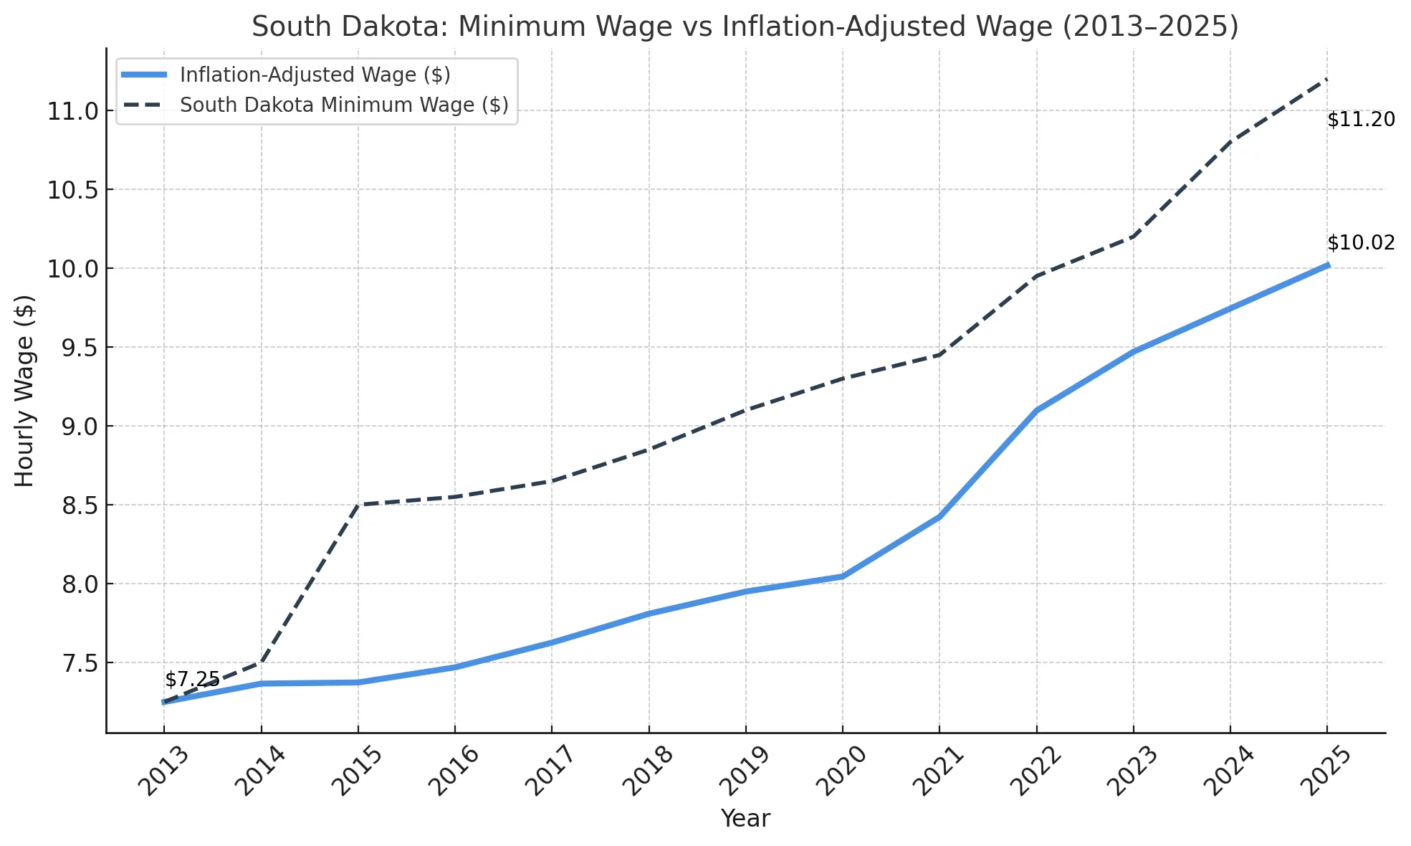
Minimum Wage vs Inflation: A Tale of Two States Iowans face shrinking purchasing power, while South Dakota’s wage growth aligns with inflation—impacting Medicaid eligibility and access.
The shaded blue area visually highlights lost purchasing power for Iowans earning minimum wage.
By 2025, they are effectively earning $2.26 less per hour than needed to keep up with inflation.
Over a full-time year, this amounts to a $4,700+ loss per person, pushing many closer to Medicaid eligibility thresholds.
Inflation-adjusted value of $7.25 (in blue)
Actual South Dakota minimum wage (in dashed dark gray)
From 2013 to 2020, South Dakota’s minimum wage trailed behind inflation.
Since 2021, proactive increases have allowed it to catch up and even exceed the inflation-adjusted line by 2025.
This helps:
Preserve workers' purchasing power
Reduce Medicaid dependency
Improve access to healthcare and insurance retention
Introduction
Geographic Trends
Funding / Forecast – Age Factor
Impact of Education
Economic Trends
Conclusion
Bibliography

Slide 20
Conclusion
How to Make Dual Eligibility Sustainable for Iowa & South Dakota.
1. Geographic Risk Concentration
“Where poverty rises and labor shrinks, dual eligibility soars.”
Our analysis reveals that high poverty, low labor participation, and stagnant economies (especially in rural Iowa) experience disproportionately high dual enrollment rates.
Lower incomes lead to Medicaid dependence, which is exacerbated by inflation and population aging.
Recommendation
Use forecasting tools to preemptively address dual eligibility surges.
2. Education’s Protective Power
“Education reduces risk—across all healthcare dimensions.”
ZIPs with higher percentages of Bachelor’s or Graduate degrees have:
Lower uninsured rates
Reduced disability burdens
Less poverty
This confirms that educational attainment is a leading indicator of long-term health stability.
Recommendation
Partner with educational institutions to run health literacy programs
3. Inflation & Stagnant Wages
“Wages stuck in time push working families into poverty—and Medicaid.”
In Iowa, the minimum wage has remained $7.25/hour for over a decade. Meanwhile, inflation and healthcare costs have risen steadily.
Result? This pulls more working individuals into Medicaid eligibility, despite being employed.
Recommendation
Advocate for wage-aligned coverage programs
Design affordability-adjusted insurance plans for minimum-wage workers
4. The Aging Wave is Here
“Iowa and South Dakota’s median age is climbing—fast.”
Between 2025 and 2040, a massive portion of the population will shift from 65+ to 75+, where:
Dual eligibility rates spike
Hospice care needs quadruple
Medicare strain intensifies
Recommendation
Invest in long-term care partnerships, especially hospice and home health
Build a dual-eligibility readiness plan based on aging trends
“Sustainability lies in being proactive, data-driven, and community-focused.”
Wellmark’s path forward should align geography, economics, education, and aging into a holistic health strategy—building resilience today to reduce healthcare strain tomorrow.
Introduction
Geographic Trends
Funding / Forecast – Age Factor
Impact of Education
Economic Trends
Conclusion
Bibliography

Slide 21
Bibliography
Key references supporting data, policy insights, and economic indicators in our dual enrollment case study.
U.S. Department of Health and Human Services. Prior HHS Poverty Guidelines and Federal Register References. https://aspe.hhs.gov/topics/poverty-economic-mobility/poverty-guidelines/prior-hhs-poverty-guidelines-federal-register-references
Medicaid Planning Assistance. Federal Poverty Guidelines Resource. https://www.medicaidplanningassistance.org/federal-poverty-guidelines/
U.S. Department of Health and Human Services. Poverty Guidelines and Federal Register Archives. https://aspe.hhs.gov/topics/poverty-economic-mobility/poverty-guidelines/prior-hhs-poverty-guidelines-federal-register-references
Medicaid Planning Assistance. Federal Poverty Guidelines Explained. https://www.medicaidplanningassistance.org/federal-poverty-guidelines/
U.S. Inflation Calculator. Current Inflation Rates and Historical Trends. https://www.usinflationcalculator.com/inflation/current-inflation-rates
Federal Reserve Bank of St. Louis (FRED). Minimum Wage in Iowa – Series STTMINWGIA. https://fred.stlouisfed.org/series/STTMINWGIA
Federal Reserve Bank of St. Louis (FRED). Minimum Wage in South Dakota – Series STTMINWGSD. https://fred.stlouisfed.org/series/STTMINWGSD
U.S. Department of Labor. State Minimum Wage Laws Overview. https://www.dol.gov/agencies/whd/minimum-wage/state
Introduction
Geographic Trends
Funding / Forecast – Age Factor
Impact of Education
Economic Trends
Conclusion
Bibliography

